Slide 1
Agile project management
Maryam Mazhar
Bscs-f19-m80
Section :B

Slide 2
Introduction
Agile Project Management (APM) can be defined as an iterative approach that promotes direct customer inclusion, adjusts to change and develops a working product.
It supports projects in rapidly changing environments characterized by technology driven innovation, global competition, accelerated lifecycles, and customer demands.
The focus changes from managing tasks and schedules to developing the best solutions with faster delivery under conditions of continuous change.

Slide 3
background
year | Author | method | conclusion
2021 | Omar El-Gayar, Cherie Noteboom | Review Planning, Review Process Data Extraction and Synthesis | effective communication and collaboration within teams and between vendor and client ensure the success of project.
2017 | Arturs Rasnacis, Solvita Berzisa | Preparation , Employees’ analysis ,PM Selection, adaptation, implementation phase | less bugs, faster delivery, more and effective communication, better quality, better risk analysis, less over costs
2019 | Enric Senabre Hidalgo | participant observation, analysis of online activity and semi-structured interviews | Adaptively

Slide 4
Cont..
year | author | method | conclusion
2019 | Faisal Hayat, Ammar Ur Rehman | Problem identification, literature review of related work, survey designing, data gathering, Data analysis, discussion, results | Scrum has positive influence on the time, cost, scope, Quality, Risk and scope of the project.
2018 | Afonso Ribeiro | Roles Documentation Information workflow | the inclusion of the feedback that it is considered relevant to software development in the methodology, in order to improve it.

Slide 5
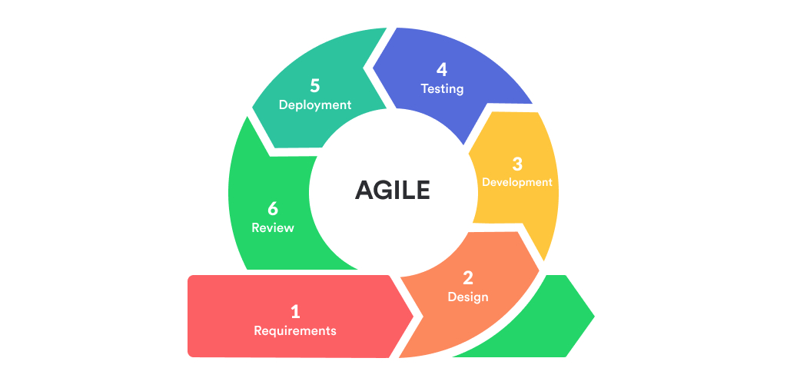
methodology

Slide 6
Scrum
Scrum is a framework for project management that emphasizes teamwork, accountability and iterative progress toward a well-defined goal.
The development process of each release should be within the limit of 30 days. For this reason, SCRUM is more suitable to short term projects.

Slide 7
results
Superior quality Product
Customer Satisfaction
Better control
Improved project predictability
Reduced risks
Increased flexibility
Improved team morale

Slide 8
conclusion
Agile models are based on iterative software development. An independent working module is built after the completion of iteration.
Iteration should not consume more than two weeks to complete a code.
Agile methodologies invite the developers to get involved in testing, rather than a separate quality assurance team.
It is suitable in changing environments because of new practices and principles that enable a team to develop a product in short duration.
Continuous improvement

